Slide 1
Garbage Collection in Java

Slide 2
Garbage collection in Java is the process by which Java programs perform automatic memory management.
Java programs compile to bytecode that can be run on a Java Virtual Machine.
When Java programs run on the JVM, objects are created on the heap, which is a portion of memory dedicated to the program.
Eventually, some objects will no longer be needed. The garbage collector finds these unused objects and deletes them to free up memory.

Slide 3
What is Garbage Collection?
In C/C++, a programmer is responsible for both the creation and destruction of objects.
Usually, programmer neglects the destruction of useless objects.
Due to this negligence, at a certain point, sufficient memory may not be available to create new objects, and the entire program will terminate abnormally, causing OutOfMemoryErrors.

Slide 4
But in Java, the programmer need not care for all those objects which are no longer in use. Garbage collector destroys these objects.
The main objective of Garbage Collector is to free heap memory by destroying unreachable objects.
The garbage collector is the best example of the Daemon thread as it is always running in the background.

Slide 5
How Does Garbage Collection in Java works?
Java garbage collection is an automatic process.
Automatic garbage collection is the process of looking at heap memory, identifying which objects are in use and which are not, and deleting the unused objects.
An in-use object, or a referenced object, means that some part of your program still maintains a pointer to that object. An unused or unreferenced object is no longer referenced by any part of your program.
So the memory used by an unreferenced object can be reclaimed. The programmer does not need to mark objects to be deleted explicitly.
The garbage collection implementation lives in the JVM.

Slide 6
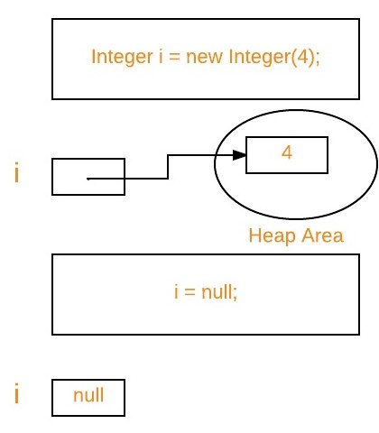
Unreachable objects:
An object is said to be
unreachable if it doesn’t contain any reference to it.
Integer i = new Integer(4);
// the new Integer object is reachable via the reference int 'i'
i = null;
// the Integer object is no longer reachable.

Slide 7
Eligibility for garbage collection:
An object is said to be eligible for GC(garbage collection) if it is unreachable.
After i = null, integer object 4 in the heap area is suitable for garbage collection in the above image.

Slide 8
Note:
Once we make an object eligible for garbage collection, it may not destroy immediately by the garbage collector.
Whenever JVM runs the Garbage Collector program, then only the object will be destroyed. But when JVM runs Garbage Collector, we can not expect.

Slide 9
Different ways to invoke Garbage Collector
We can also request JVM to run Garbage Collector. There are two ways to do it :
Using System.gc() method: System class contain static method gc() for requesting JVM to run Garbage Collector.
Using Runtime.getRuntime().gc() method: Runtime class allows the application to interface with the JVM in which the application is running. Hence by using its gc() method, we can request JVM to run Garbage Collector.
There is no guarantee that any of the above two methods will run Garbage Collector.
The call System.gc() is effectively equivalent to the call Runtime.getRuntime().gc()

Slide 10
Finalization
Just before destroying an object, Garbage Collector calls finalize() method on the object to perform cleanup activities.
Once finalize() method completes, Garbage Collector destroys that object.
finalize() method is present in Object class with the following prototype.
protected void finalize() throws Throwable

Slide 11
finalize()
Based on our requirement, we can override finalize() method for performing our cleanup activities like closing connection from the database.
The finalize() method is called by Garbage Collector, not JVM. However, Garbage Collector is one of the modules of JVM.
Object class finalize() method has an empty implementation. Thus, it is recommended to override the finalize() method to dispose of system resources or perform other cleanups.
The finalize() method is never invoked more than once for any object.
If an uncaught exception is thrown by the finalize() method, the exception is ignored, and the finalization of that object terminates.

Slide 12
Advantages of Garbage Collection in Java
It makes java memory-efficient because the garbage collector removes the unreferenced objects from heap memory.
It is automatically done by the garbage collector(a part of JVM), so we don’t need extra effort.

Slide 13
Nested Classes
The Java programming language allows you to define a class within another class. Such a class is called a nested class.
Syntax:
class OuterClass {
...
class NestedClass {
...
}
}

Slide 14
Nested classes are divided into two categories: non-static and static.
Non-static nested classes are called inner classes.
Nested classes that are declared static are called static nested classes.
class OuterClass {
...
class InnerClass {
...
}
static class StaticNestedClass {
...
}
}

Slide 15
Why to Use Nested Classes?
It is a way of logically grouping classes that are only used in one place: If a class is useful to only one other class, then it is logical to embed it in that class and keep the two together.
It increases encapsulation: Consider two top-level classes, A and B, where B needs access to members of A that would otherwise be declared private. By hiding class B within class A, A's members can be declared private and B can access them. In addition, B itself can be hidden from the outside world.
It can lead to more readable and maintainable code: Nesting small classes within top-level classes places the code closer to where it is used.

Slide 16
To instantiate an inner class, you must first instantiate the outer class. Then, create the inner object within the outer object with this syntax:
OuterClass outerObject = new OuterClass();
OuterClass.InnerClass innerObject = outerObject.new InnerClass();
To create an object for the static nested class, use this syntax:
OuterClass.StaticNestedClass nestedObject = new OuterClass.StaticNestedClass();

Slide 17
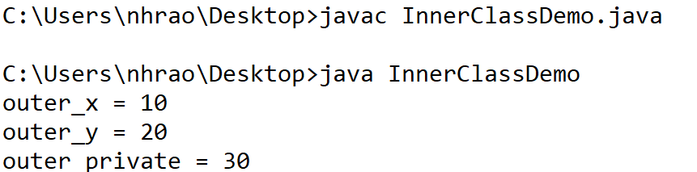
Example1:
// Java program to demonstrate accessing
// a inner class
class OuterClass
{
// static member
static int outer_x = 10;
// instance(non-static) member
int outer_y = 20;
// private member
private int outer_private = 30;
// inner class
class InnerClass
{
void display()
{
// can access static member of outer class
System.out.println("outer_x = " + outer_x);
// can also access non-static member of outer class
System.out.println("outer_y = " + outer_y);
// can also access a private member of the outer class
System.out.println("outer_private = " + outer_private);
}
}
}
public class InnerClassDemo
{
public static void main(String[] args)
{
// accessing an inner class
OuterClass outerObject = new OuterClass();
OuterClass.InnerClass innerObject = outerObject.new InnerClass();
innerObject.display();
}
}

Slide 18
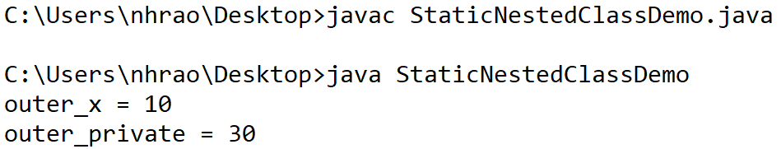
Example 2:
// Java program to demonstrate accessing
// a static nested class
class OuterClass
{
// static member
static int outer_x = 10;
// instance(non-static) member
int outer_y = 20;
// private member
private static int outer_private = 30;
// static nested class
static class StaticNestedClass
{
void display()
{
// can access static member of outer class
System.out.println("outer_x = " + outer_x);
// can access display private static member of outer class
System.out.println("outer_private = " + outer_private);
// The following statement will give compilation error
// as static nested class cannot directly access non-static members
// System.out.println("outer_y = " + outer_y);
}
}
}
public class StaticNestedClassDemo
{
public static void main(String[] args)
{
// accessing a static nested class
OuterClass.StaticNestedClass nestedObject = new OuterClass.StaticNestedClass();
nestedObject.display();
}
}

Slide 19
Comparison between normal or regular class and static nested class
S.NO | Normal/Regular inner class | Static nested class
1. | Without an outer class object existing, there cannot be an inner class object. That is, the inner class object is always associated with the outer class object. | Without an outer class object existing, there may be a static nested class object. That is, static nested class object is not associated with the outer class object.
2. | Inside normal/regular inner class, static members can’t be declared. | Inside static nested class, static members can be declared.

